Slide 1
F# for Data Science F# DataFrame, F# Data and F# Charting
Tomas Petricek @tomaspetricek | tomas@tomasp.net

Slide 2
Download
http://tinyurl.com/fs-dataframe

Slide 3
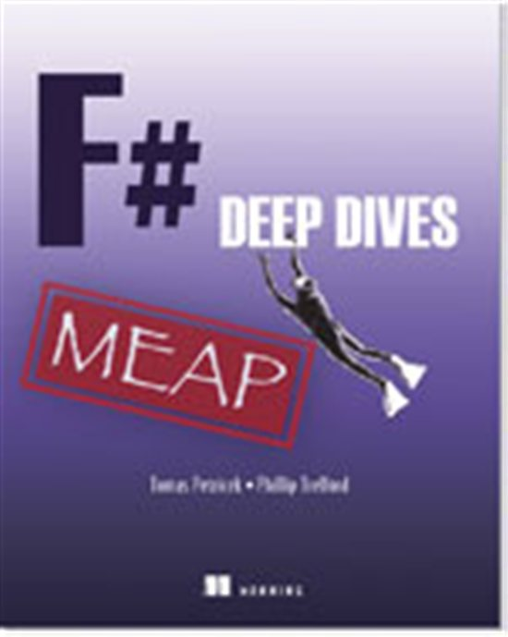
F# Deep Dives
44% off for Progressive F# Tutorials audience
Use: mlpetricek2cf At: manning.com/petricek2

Slide 4
How to write calculations in F#
F# core library
F# language & F# PowerPack
Open-source and community
F# DataFrame, F# Charting, Math.NET
Fmat (from StatFactory)
Professional libraries & tools
StatFactory FCore, FCell etc.

Slide 5
F# Data Science libraries
F# Data (http://github.com/fsharp/FSharp.Data)
Type providers for getting data
WorldBank, Freebase, XML, CSV, JSON, …
F# Charting (http://github.com/fsharp/FSharp.Charting)
Simple charting using WinForms & ASP.NET
Plays well with F# Interactive

Slide 6

F# Data Science libraries
Introducing…
Internship project @ BM…
New open-source library…
F# DataFrame (http://github.com/BlueMountainCapital)
Structured data aka CSV files on steroids
Time series data with “index”
Missing values, stats, fancy grouping, …

Slide 7
F# DataFrame library
Used for “implementing systematic trading strategies and for computing signals that researchers and portfolio managers look at to inform investment decisions.”
Contributions & feedback welcome!

Slide 8
F# DataFrame et al. in action

Slide 9
DEMO #1 NY (state) mortality in CSV

Slide 10
DEMO #2 Life expectancy from WorldBank

Slide 11
DEMO #3 Per second price processing

Slide 12
Summary

Slide 13
Summary
Used a bunch of libraries
F# Data – getting data from various sources
F# Charting – simple interactive visualizations
F# DataFrame – data alignment, processing
What these libraries do not do?
Optimized statistics and linear algebra
Let you build user-friendly spreadsheets

